Slide 1
Advances in Deep Learning for Auction Design: Fairness, Robustness, and Expressiveness
Michael J. Curry
Joint work with
Ping-yeh Chiang, Samuel Dooley, John Dickerson, Tom Goldstein, Elizabeth Horishny, Kevin Kuo, Uro Lyi, and Anthony Ostuni

Slide 2
Market design is a kind of economic engineering, utilizing laboratory research, game theory, algorithms, simulations, and more.
Its challenges inspire us to rethink longstanding fundamentals of economic theory.
– Paul Milgrom, presentation when awarded 2008 Erwin Plein Nemmers Economics Prize

Slide 3
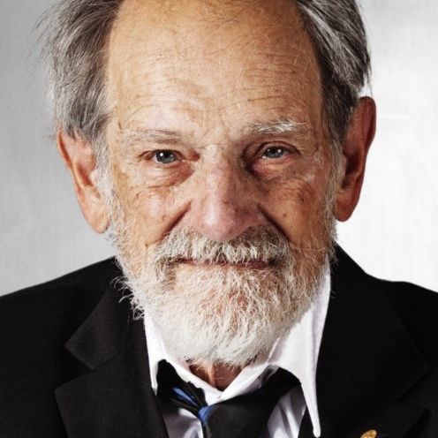




Market Design*
*for the sake of this talk, at least!
Market design is partially based on mechanism design, i.e., the design of incentives, toward a particular goal, in a strategic setting with one or more agents.
Design of incentives:
Pricing and allocation rules in auctions
Joining an agent to a contract in a matching market
Toward a particular goal:
Maximize global welfare
Ensure some notion of fairness
Maximize revenue of the clearinghouse aka principal
Strategic settings:
Agents’ strategies are chosen knowing that their outcome will depend also on other agents’ choices
“Sveriges Riksbank Prize in Economic Sciences in Memory of Alfred Nobel” in 2020 (Paul Milgrom & Robert Wilson); 2012 (Al Roth & Lloyd Shapley); 2007 (Roger Myerson, Leonid Hurwicz, & Eric Maskin).

Slide 4
Market Auction Design*
*for the sake of this talk, at least!
An auction mechanism is run by a central coordinator, who asks agents to report their preferences and then aggregates them in some way before deciding on an allocation and payments
Agents have private information about preferences (i.e., their private type θ), and can choose to lie about them to the coordinator
The distribution over which they draw their types is known to all.

Slide 5
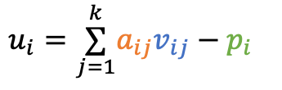
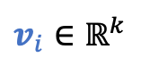
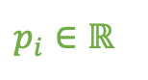
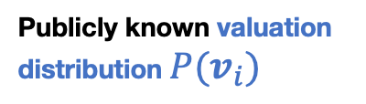
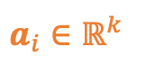
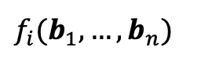
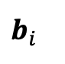
Auction Model*
Items: j = 1, 2, …, k
Agents: i = 1, 2, …, n
*for the sake of this talk, at least!
Publicly known valuation distribution $P(v_{i})$
The mechanism outputs allocations of items, and a payment to charge each player
Private valuations
$$v_{i}∈ℝ^{k}$$
Players receive utility based on allocations, payments, and their private valuation.
$$a_{i}∈ℝ^{k}$$
$$b_{i}$$
$$f_{i}(b_{1},…,b_{n})$$
$$u_{i}=\overset{k}{\underset{j=1}{∑}}a_{ij}v_{ij}−p_{i}$$
Players strategically choose bids and send them to the allocation mechanism f
$$p_{i}∈ℝ$$
(Utilities may also take forms other than quasilinear.)

Slide 6
Mechanism Design & Equilibrium Behavior
Common assumptions of mechanism design:
Agents are rational utility maximizers (rational in a very strong sense)
Will play a (Bayes-)Nash equilibrium
Designing a mechanism with "good" equilibrium behavior is hard.
Here, “good” means our mechanism implements a function f (e.g., social welfare maximization) under agents’ strategic behavior.
Θ
O
θ
f(θ)
NE(M, Game, θ)
M, Game
Notes:
Rational, with unbounded computational resources. They will always play perfectly and always find any weakness in your mechanism.
It can be hard to just figure out what the equilibrium would be, let alone optimize to find a good one.

Slide 7
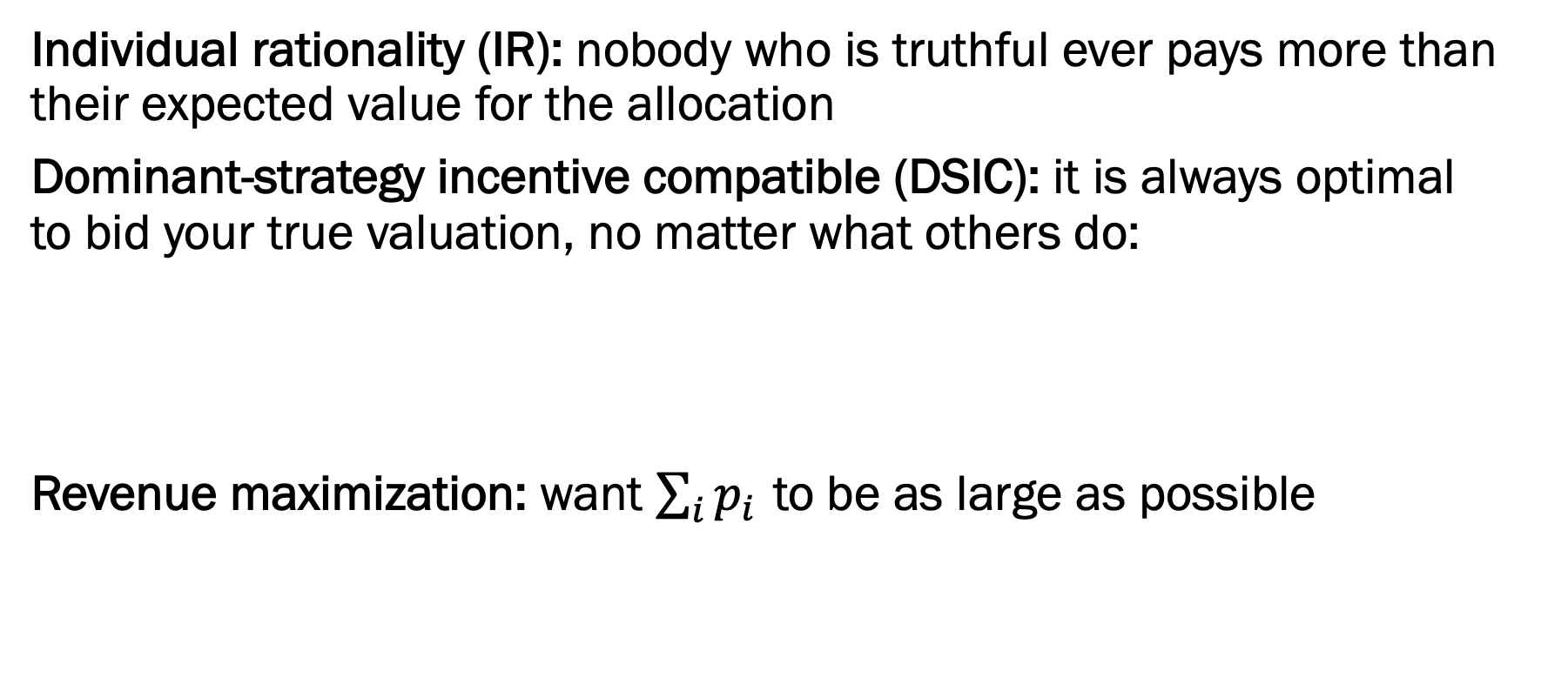
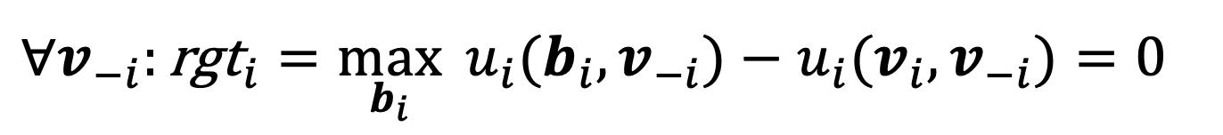
Desirable Properties of Auctions
Individual rationality (IR): nobody who is truthful ever pays more than their expected value for the allocation
Dominant-strategy incentive compatible (DSIC): it is always optimal to bid your true valuation, no matter what others do:
Revenue maximization: want $\sum_{i}{p_{i}}$ to be as large as possible
$$∀v_{−i}:{\text{rgt}}_{i}=\max_{b_{i}}{{ u}_{i}(b_{i},v_{−i})−u_{i}(v_{i},v_{−i})=0}$$
Notes:
First, individual rationality. You want to guarantee that nobody should ever come out of your auction with negative expected utility — in other words, never charge them more than what their winnings are worth. Otherwise, people would just choose to opt out of your mechanism.
Second: We want an auction that is dominant strategy incentive compatible aka strategyproof or truthful: nobody should have any incentive to lie, no matter what the other players do. In mathematical terms, we want this quantity regret, which is defined as the difference in utility between the truthful bid and the best strategic bid, to be 0.
Third: we want to charge people as much money as we can get away with subject to the first two constraints.

Slide 8
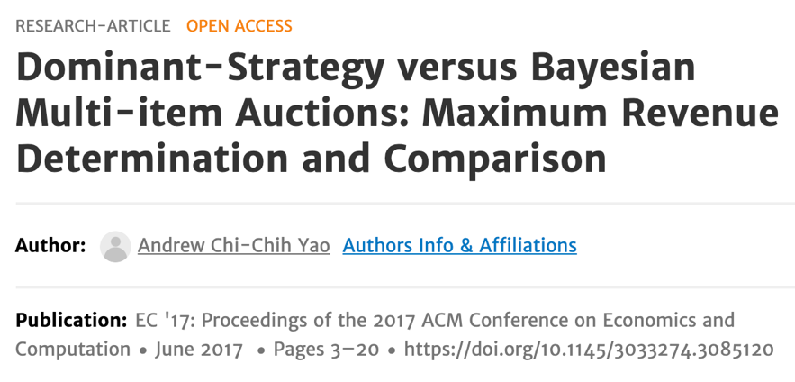
Optimal Auction Design I
An optimal auction is incentive compatible and revenue-maximizing.
Analytic results are very tough to create:
Myerson [1981] resolved for 1 item!
Some progress since then, but 2 items & 2 bidders is not fully resolved, still …
Many nice recent works (from Econ, CS, Math, OR/MS, …), typically focus on BNIC instead of DSIC, though …
Myerson [1981]: DSIC = BNIC revenue, 1 item case
Yao [2017]: DSIC ≠ BNIC revenue, 2 item case
&
Exact formulaic results for 2 items, distribution with support of size 2.
Notes:
Myerson’s auction has optimal revenue amongst DSIC mechanisms *AND* amongst the relaxed, larger class of BNIC mechanisms.
From Yao: For instance, if k=n=2 and Pr{X_{{F} = 1} = Pr{X_{F} =2 } = 1/2, then the maximum revenue in the Bayesian implementation exceeds that in the dominant-strategy by exactly 2%; the same gap exists for the continuous uniform distribution X_{F} over [a, a+1] ∪ [2a, 2a+1] for all large a.

Slide 9
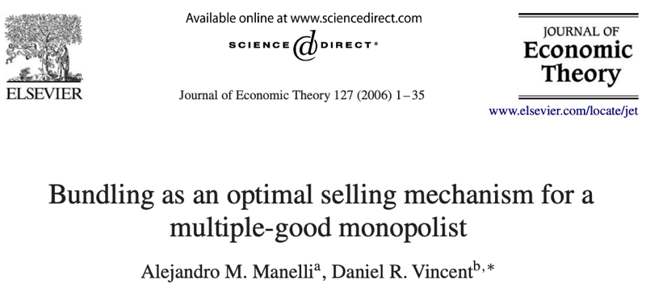
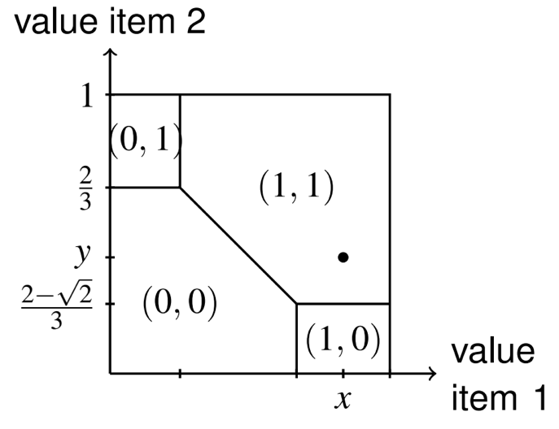
Optimal Auction Design II
Analytic results are very tough to create.
2 item, 1 bidder with additive valuations [Manelli-Vincent 2006, Giannakopoulos&Koutsoupias 2015, Haghpanah&Hartline 2015, Daskalakis+ 2017, ..]
2 items, unit-demand bidders [Pavlov 2011]
Something to keep in mind:
Not allocating an item → not okay in social welfare maximization
Not allocating an item → sometimes okay in revenue maximization
Intuition: you get nothing for selling nothing, but you can “beat second price/VCG” if you do end up selling it
Notes:
Manelli-Vincent:
1 bidder
2 items
Additive valuation, values drawn IID from U[0,1]
Optimal allocation
(Figure from David Parkes)

Slide 10

What If There Are Multiple Items and More Than 1 Bidder …?
Not totally out of luck!
Informed by theoretical analyses of smaller, general systems
Can design approximately optimal mechanisms
Can use automated mechanism design [Conitzer&Sandholm 2002]
We’re most motivated by the general pitch of (3) – “automatically” designing a mechanism for a specific problem instance, but …
... older methods run into severe scalability issues, so not practical.

Slide 11

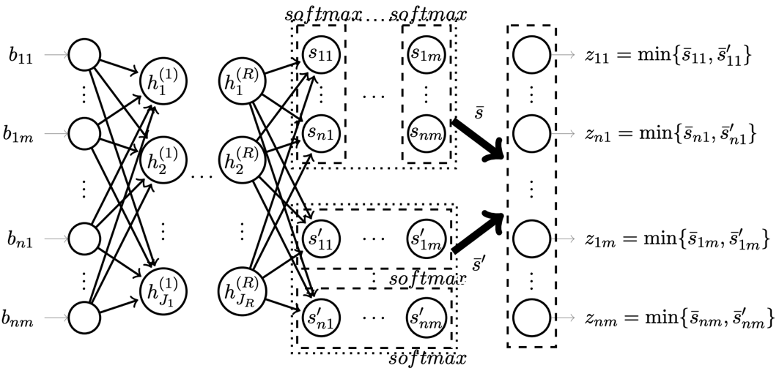
Recall: Auction Model*
*for the sake of this talk, at least!
Publicly known valuation distribution $P(v_{i})$
The mechanism outputs allocations of items, and a payment to charge each player
Private valuations
$$v_{i}∈ℝ^{k}$$
Players receive utility based on allocations, payments, and their private valuation.
$$a_{i}∈ℝ^{k}$$
$$b_{i}$$
$$f_{i}(b_{1},…,b_{n})$$
$$u_{i}=\overset{k}{\underset{j=1}{∑}}a_{ij}v_{ij}−p_{i}$$
Players strategically choose bids and send them to the allocation mechanism f
$$p_{i}∈ℝ$$

Slide 12
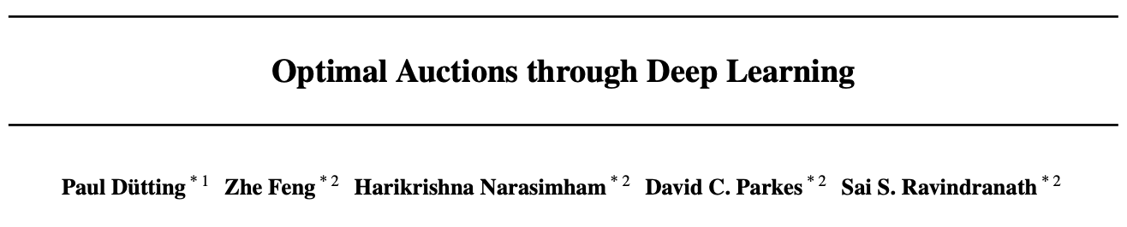
Differentiable Economics
Differentiable programming — term coined by Yann LeCun
“OK, Deep Learning has outlived its usefulness as a buzz-phrase. Deep Learning est mort. Vive Differentiable Programming! …Yeah, Differentiable Programming is little more than a rebranding of the modern collection Deep Learning techniques…”
“But the important point is that people are now building a new kind of software by assembling networks of parameterized functional blocks and by training them from examples using some form of gradient-based optimization. “
Differentiable economics — term coined in same spirit by David Parkes
Combines the same basic building blocks to create mechanisms that are differentiable, allowing them to be optimized using gradient descent

Slide 13
RegretNet (and other, similar networks)
Focus on optimal auctions: DSIC (i.e., strategyproof) & revenue maximizing
Dütting et al, “Optimal Auctions Through Deep Learning”: parameterize auction mechanism (function f from bids to winners/payments in previous slide) as deep neural network:
Maximization of revenue → include a revenue term in the loss function during training
Strategyproofness constraint → compute strategic inputs via gradient ascent, train on these to reduce how much strategyproofness is violated
Notes:
- if you’re running an auction, you want to make money. But auction participants don’t want to spend money, and might behave strategically. Ideally, you would want to prevent this.
Limited cases: second-price auction is strategyproof, when selling a single item with a carefully-chosen reserve price (Myserson) it is revenue maximizing. Other cases involve selling two items to 1 bidder.
VCG is welfare maximizing but NOT revenue-maximizing.
This paper comes at the problem sideways. The idea is that the auction mechanism is just a function, so you can parameterize it as a neural network and then cook up a loss function to learn these desirable properties.

Slide 14

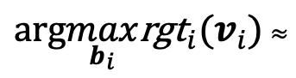
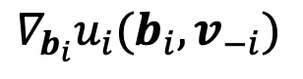
Estimating Regret
Given f and a draw v_{i}, how to compute $\max_{b_{i}}{ u}_{i}\left(b_{i},v_{−i}\right)−u_{i}\left(v_{i},v_{−i}\right)$?
Just do gradient ascent on utility!
Networks and inputs relatively small, so can do many steps (25 train time, 1000 test time)
(Easily implemented in PyTorch by just setting requires_grad=True on input tensors)
$arg\max_{b_{i}}{\text{rgt}}_{i}(v_{i})$ $≈$
$$∇_{b_{i}}u_{i}(b_{i},v_{−i})$$
Notes:
Because these neural networks are small, you can do a lot of steps pretty cheaply (they use 25 per batch at train time and 1000 at test time.) They also cache the perturbed input from the previous epoch, and use it as the starting point for the next epoch.

Slide 15
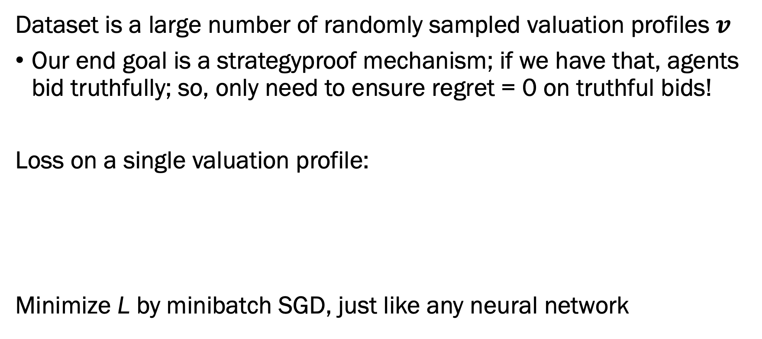
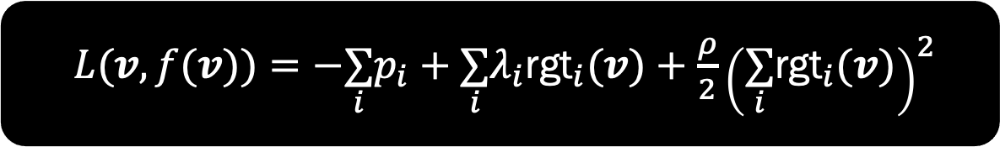
Learning Procedure
Dataset is a large number of randomly sampled valuation profiles $v$
Our end goal is a strategyproof mechanism; if we have that, agents bid truthfully; so, only need to ensure regret = 0 on truthful bids!
Loss on a single valuation profile:
Minimize L by minibatch SGD, just like any neural network
Penalize low profit
Penalize high regret
$L(v,f(v))=−\underset{i}{∑}p_{i}+\underset{i}{∑}λ_{i}{\text{rgt}}_{i}(v)+\frac{ρ}{2}{\left(\underset{i}{∑}{\text{rgt}}_{i}(v)\right)}^{2}$
Notes:
So now we have a network that is guaranteed to be incentive compatible, we have a way of estimating regret, how can we cook up a training procedure to ensure our other two properties?
Our dataset is a bunch of sampled valuations. If we had a strategyproof mechanism, then people would only bid truthfully, so it’s enough to assume truthful inputs and ensure regret is low on those only.
We define a loss function to minimize regret while maximizing negative revenue. Since the regret term involves computing an adversarial input, the whole process looks a lot of like adversarial training.
You have two regret terms here: having them both helps make the problem better behaved, in ways I don’t understand well.

Slide 16
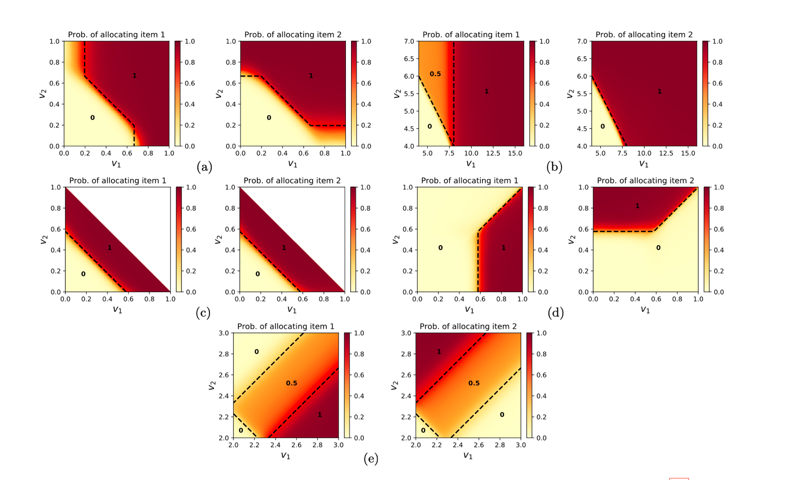
Successful Results
Dotted lines denote theoretically optimal mechanism; orange/red is what neural networks learned after training
Notes:
There are some known revenue-maximizing DSIC auctions for the case where there is only one bidder bidding on two items, with different distributions over valuations. These plots show that the neural network trained using this procedure is able to learn them, at least approximately.

Slide 17
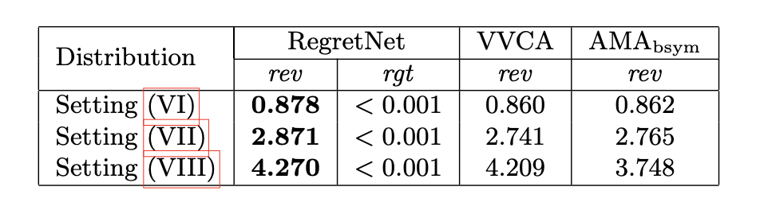
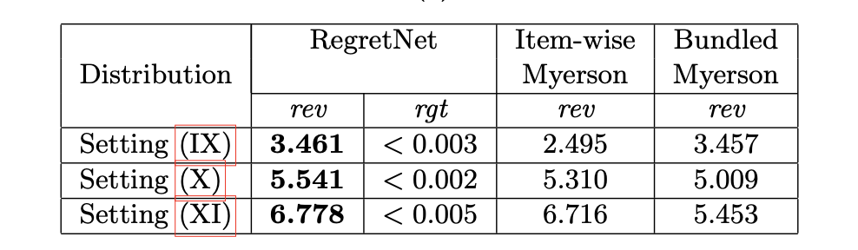
Successful Results
Their approach also beats a variety of strong baselines in more complicated situations where the optimal mechanism is not known.
Notes:
They also do well against strong approximate baselines in cases where the optimal auction is not known.

Slide 18
New Takes on Differentiable Economics
ProportionNet: Balancing Fairness and Revenue For Auction Design With Deep Learning (u.r. 2021)
Impose fairness constraints on allocations
Certifying Strategyproof Auction Networks (NeurIPS 2020)
Compute regret exactly — no gradient-based approximation
Learning Revenue-Maximizing Auctions With Differentiable Matching (u.r. 2021)
Sinkhorn algorithm to perform differentiable matching; allows for new demand types (e.g., k-unit demand)
Curry*, Chiang*, Goldstein, Dickerson. Certifying Strategyproof Auction Networks. NeurIPS-20.
Kuo*, Ostuni*, Horishny*, Curry*, Dooley*, Chiang*, Goldstein, Dickerson. ProportionNet: Balancing Fairness and Revenue for Auction Design with Deep Learning. Under review, 2021.
Curry*, Lyi*, Goldstein, Dickerson. Learning Revenue-Maximizing Auctions With Differentiable Matching. Under review, 2021.

Slide 19

ProportionNet

Slide 20
Unfairness in Advertising
Recent work showcases discrimination in online advertising
Google displayed job listings of a higher income to men, and lower income job listings to women [Datta et al. 2015].
Facebook sent ads discriminating on gender regardless of advertiser preferences [Muhammad et al. 2019].
Online ads have been shown to discriminate on race, history of drug use, parent status, etc [Chawla et al. 2020].
Unintentional, but not necessarily inevitable.
New Goal: prevent unfair* allocations between users.
*for some definition of “unfair” – this is, of course, a morally-laden step to take and deciding on which definition of fairness, if any, should be incorporated into an automated decisioning system is one that should, necessarily, involve stakeholder discussion.
Notes:
Besides online marketing being one of the most profitable places to do research, there has been quite a few reasons to delve into online ad auctions in particular. Recent studies have showcased examples of Google and Facebook ad auctions’ carrying out results that could be considered discriminatory or unfair in regards to their users. For instance, it’s been shown that, either intentionally or unintentionally, that when looking for job listings, women were shown lower-income Google Ad results in comparison to males searching. Furthermore, discrimination in regards to users with a search history insinuating their financial status, race, medical history, criminal history, etc. has been used to skew advertisements for employment opportunities, housing opportunities- things that should not offered differently for users of, say different races, genders, parent status, or other irrelevant characteristics.
So, with these examples in mind, we wanted to design a fair auction. We entertained quite a few defintions of fairness, because fairness as a concept is pretty vast. At first we considered implementing fair auctions in terms of the bidders- perhaps bidders can only win a select number of items, or perhaps we ensure that everyone who participates in an auction will win a certain number of allocations. But, in the end it seemed more ethical to implement fairness in regards to the users, who are being bid for. In a normal auction of items, this idea comes across as strange, but it made sense for our purposes.

Slide 21
A Specific Application of Auction Design
Auctions are used by many platforms to decide online ad allocations.
Advertiser i bids for a user j, and the auctioneer allocates users (i.e., “items”) depending on bids.
Other qualities, such as relevancy, impact allocation decisions as well.
We would like to prevent these allocations from inducing unfairness.
Past real-world experimentation surfaces that online advertising systems show ads (e.g., career advancement opportunities) at different rates to equally-qualified individuals.
Notes:
I’d imagine all of you are familiar with targeted advertising, or personalized ads- in which advertisements are funneled towards users that a platform considers as relevant. But, oftentimes the process of matching a user with an ad isn’t as simple as advertisers buying ad space, and picking who they want to see it. There’s simply too many advertisers and too many users. So, in order to navigate how ad space is allocated, online advertisements will often follow an auction mechanism. Back in the day, Google was the first to introduce this method into their search engine. Here, an advertiser will list search queries and users relevant to them, and a bid with how much they value their ad being shown. Google, who in this case is the auctioneer, will then determine which advertiser ‘wins’ the ad slot shown to a user. A decision based on the bid and the quality or relevance of an ad. These kinds of auctions occur perpetually in mere milliseconds and have since been adopted by just about every popular online platform in existence.

Slide 22
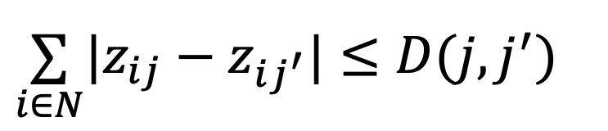
Our Definition of Fairness
Total Variation Fairness: users who are similar should be allocated advertisements similarly [Dwork+ 2012, Chawla+ 2020].
The more similar users are, the smaller their distance D. Similar users must be treated similarly.
Between two users j and j’, the allocation vector z is fair if:
For our setting: D should take into account relevant differences but ignore differences in protected attributes.
We use total variation fairness as an example. However, again, what constitutes “fair” is up to the auctioneer and other stakeholders impacted by the system.
$$\underset{i∈N}{∑}|z_{ij}−z_{ij^{′}}|≤D(j,j^{′})$$
Notes:
Fairness in an auction setting has been explored before, and we had a lot of definitions to go off of. But, the one we thought we could implement into a deep learning framework, such as regretnet, was this definition of Total Variation Fairness. Essentially, two users who ‘similar’ should be allocated advertisements ‘similarly’, or more specifically, the likelihood, or probabilities of seeing certain ads should be similar. So for instance, if we had some users, all of which looking for a job, the advertisement listings should only take relevant characteristics, such as the location of the user, and disregard everything else. These two should be shown a similar distribution of ads, whereas this dude should not.
clyde doesn’t believe they invented the definition XD
provide a technical definition

Slide 23
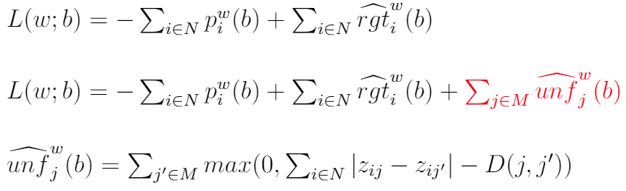
ProportionNet’s Loss Function
RegretNet-style loss:
ProportionNet loss:
Total Variation Fairness:
(Network architecture and training can stay the same — we are still enforcing strategyproofness and maximizing revenue.)
Notes:
old loss function seeks to maximize payment (minimize negative payment) and minimize regret
now we have an extra constraint term that seeks to minimize unfairness
we define unfairness as a value for every item in the auction - and the unfairness for a particular item is the sum of pairwise unfairness between all other items.
note that we modify the fairness inequality in the previous slide by subtracting D from both sides, then define loss as a metric of how much that inequality is violated

Slide 24
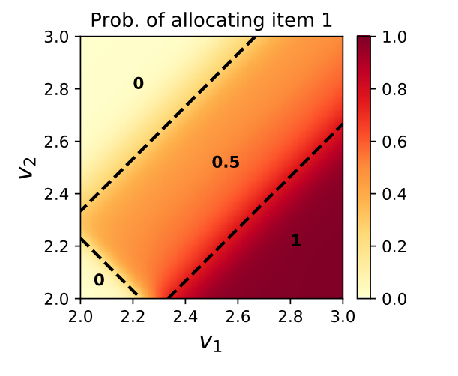
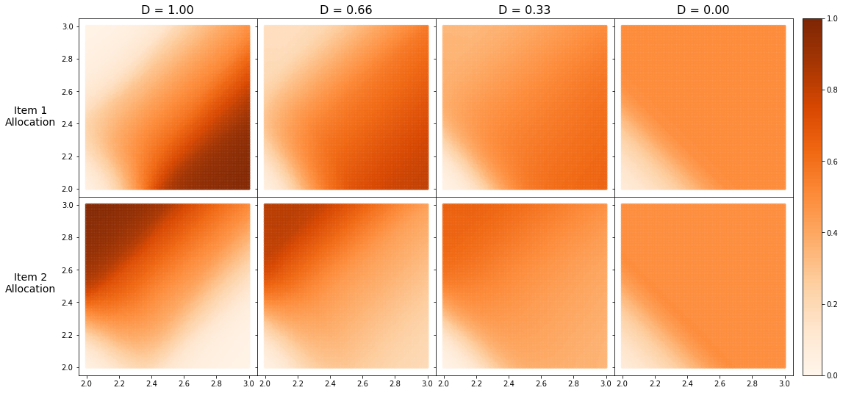
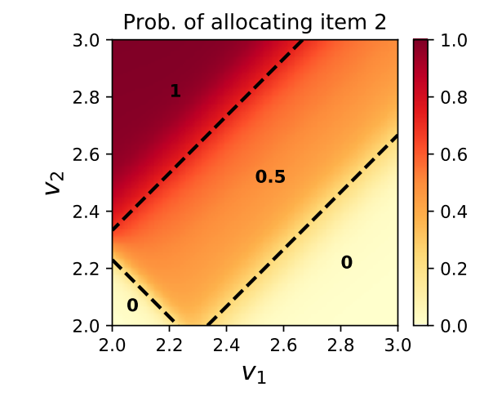
Sample Results
ProportionNet in same setting with increasingly strong fairness constraints:
Results from original RegretNet
(Unit demand, U[2,3], 2 items):
← Efficiency Fairness →

Slide 25
ProportionNet: Discussion
We present one way to learn auctions with fairness constraints on allocations.
Amenable to user “knob turning” – with regard to the intensity of the fairness regularizer & the definition of fairness itself.
Measuring expected unfairness can’t be done directly (we must estimate from samples of valuation profiles).
Similar to Dütting [2019], we can bound generalization error & show that our sample estimate is a good upper bound of true expected unfairness
Our model of fairness is motivated by real advertising auctions, but it is still extremely stylized. Discussion with real policymakers and stakeholders is important.

Slide 26

Certifying Strategyproof Auction Networks

Slide 27
Limitation of RegretNet (& ProportonNet)
The RegretNet family is concerned with minimizing regret.
Gradient-based approximation: good for training, but may underestimate regret.
We would rather compute regret exactly — but how?
Integer programming (ILP) techniques from robustness literature

Slide 28


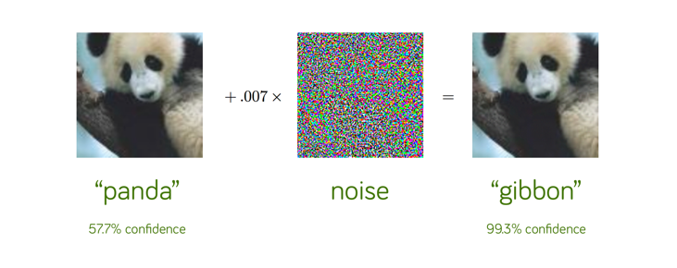
ILP for Neural Networks
Modern neural networks are mostly piecewise linear (ReLU)
It is possible to embed them into integer programs using big-M formulation for nonlinear activations
One can then maximize over inputs
Often: worst-case adversarial image
Our case: highest-regret bid
Notes:
You can get tight upper/lower bounds for big-M by solving convex relaxation of network.

Slide 29
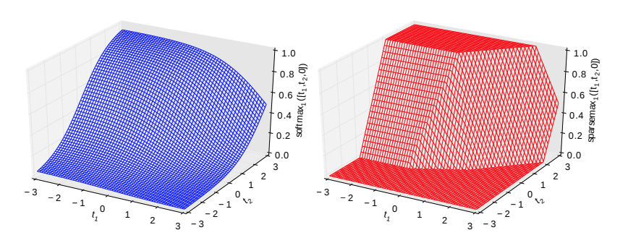


Challenge: Allocation Constraints
RegretNet uses a softmax to enforce allocation constraints (must sum to 1).
No way to get rid of it, but can’t fit directly into integer linear program.
Solution: replace with sparsemax
Formulate as optimization problem (projection), embed KKT conditions as additional constraints
(technically SOS1 not linear but still easy to deal with...)

Slide 30

Challenge: Individual Rationality
RegretNet’s architecture enforces individual rationality exactly
In an ILP, this is a (nonconvex) bilinear equality constraint (product of two disjoint variables, i.e., “charge payment iff allocated item”).
Two solutions we’ve tried:
Eliminate it and add a penalty term to encourage IR instead.
Surprisingly, the newest version of Gurobi* can deal with these …
* Gurobi 9.1 and later: “Bilinear constraints are a special case of non-convex quadratic constraints, and the algorithms Gurobi uses to handle the latter are also well suited to solving bilinear programming problems.”

Slide 31
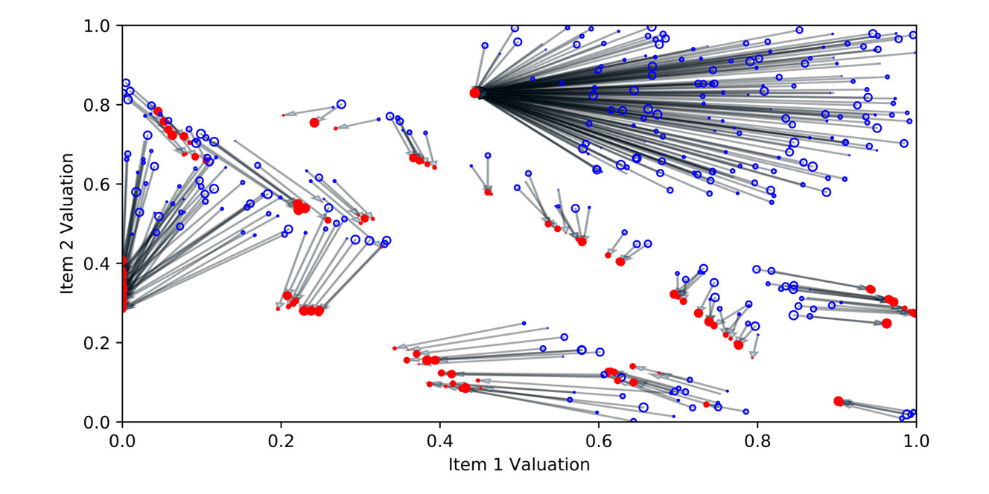
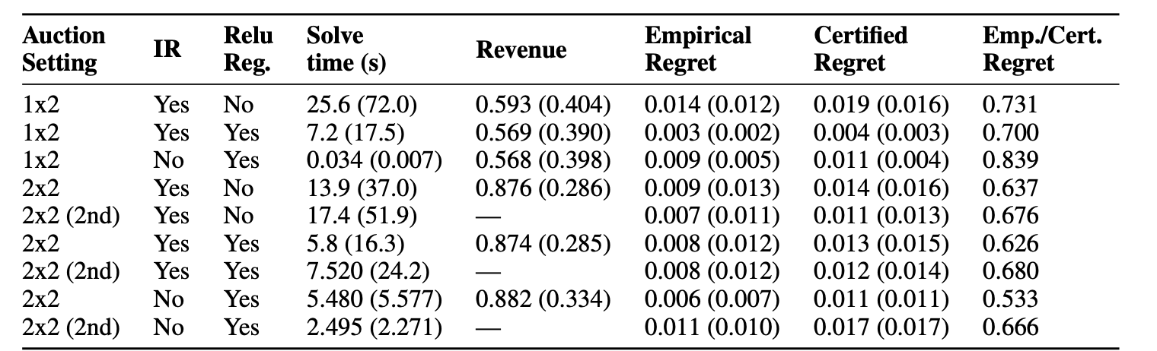
Experimental Results: Certifying RegretNet
2 items, 1 bidder, normal RegretNet: blue circles are truthful bids, red circles are (non-truthful) bids that result in gain >0.005 computed by our certifier.
Comparison of empirical regret (computed via ”normal” gradient-based approximation a la RegretNet) to our certified regret, under hard IR and regularized IR training.
Notes:
BOTTOM FIGURE is from our NeurIPS-20 paper – points with at least 0.005 regret are shown. In blue is a truthful bid, in red is the best strategic bid computed by our certifier. (For a normal RegretNet, 2 items, 1 bidder.)

Slide 32
Certifying Auction Networks: Discussion
RegretNet’s gradient-based approximate computation underestimates regret → will not reach global optimality
We can produce bounds on the maximum regret a player could suffer under a particular valuation profile
Nice to maintain provable properties with deep learned mechanisms!
Scalability remains an issue (but our ILP solution method is relatively naïve)
Local bounds only – but enough local bounds do guarantee global properties “with high probability” – future work is global bounds on regret

Slide 33

Learning Revenue-Maximizing Auctions With Differentiable Matching

Slide 34
RegretNet: Feasible Allocation via Softmax
Feasibility of final allocation matrix is enforced via a mixture of softmaxes and mins (e.g., to prevent over-allocation) at output layer
Structure is dependent on the demand type of bidders
Example (unit-demand), where bidders want at most one item:
Softmax over rows (allocate at most 1 mass of any single item)
Softmax over cols (allocate at most 1 “item mass” to a bidder)
Min over both enforces the unit-demand constraint
Combinatorial setting is similar, but needs separate output head for every possible bundle of items (= very large!)

Slide 35
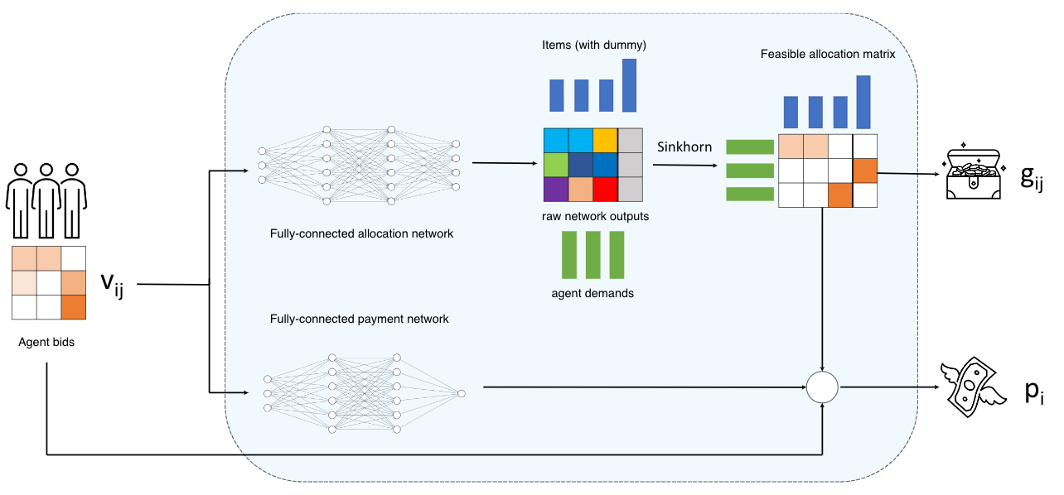
Feasible Allocation via Matching LP?
Feasible allocation of items to bidders is just a bipartite matching
Formulate as a (discrete) optimal transport problem:
“Move a set of masses to another place while minimizing cost”
Discrete version is a minimum cost bipartite matching!
Agents bid on items
Inputs to feedforward network(s)
Outputs become cost matrix for OT
OT gives (approximate) permutation matrix, yielding allocation and charging agents payment based on value of items

Slide 36
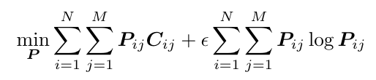
Training
Lots of ways to solve discrete OT; we use the Sinkhorn algorithm:
Iterative, GPU-parallelizable solution method (for entropy regularized version OT problems)
Forward pass: Sinkhorn algorithm
Backward pass: use autodiff to backprop through several iterations of numerical operations of that iterative algorithm!
Notes:
Entropy regularization lets us use iterative algorithm AND makes the problem strongly convex.
Epsilon parameter controls strength of regularization – if it’s big, desired permutation matrix P becomes uniform; toward zero, this trends toward a permutation
--- hyperparameter tune to keep it as small las possible without killing off the gradient entirely

Slide 37
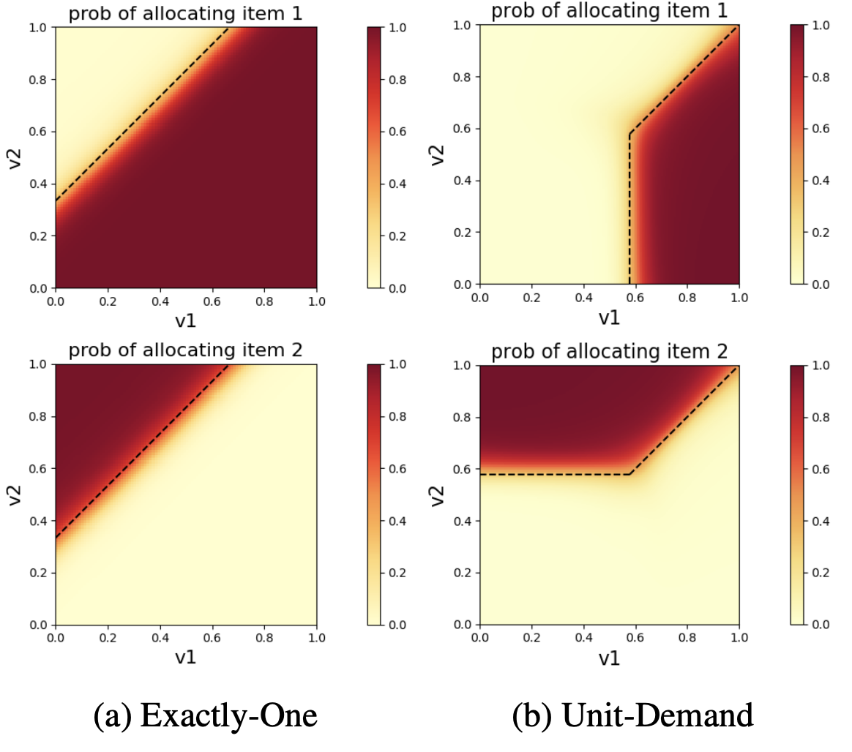
Sample Results
2 items, 1 bidder, valuations drawn independently from U[0,1] for two cases:
Unit demand (right), which can be represented by RegretNet
Exactly-one demand (left), which cannot! Optimal mechanism due to Kash & Frongillo [2016].
Notes:
In some cases, ad-hoc changes could be made to the architecture to support other settings. For example, it is possible to support ``at-most-$k$'' demand by scaling the unit-demand outputs by a factor of $k$. In the single-agent case, it is possible to produce exactly-$k$ demand by removing the dummy item which allows for the possibility of allocating no item. However, in the multi-agent unit-demand setting (which requires taking the minimum of two softmax operations) RegretNet cannot represent exactly-$k$ demand.
By contrast, in multi-agent settings with exactly-$k$ demand, the Sinkhorn-based architecture can ensure feasible outputs by simply specifying the correct marginals. Our network architecture is also independent of the demand type since only the marginals change rather than the entire network output structure.

Slide 38

Future Work

Slide 39
Learning Human Preferences
Total-variation fairness, or any other definition, are somewhat arbitrary notions of fairness.
Can we instead learn, by asking humans, a set of preferences around fairness, diversity, or other vague concepts, and then learn an auction that satisfies these preferences?

Slide 40
Proving Optimality Via Optimal Transport
In single-agent, multi-item settings, there is duality theory for proving proposed mechanisms optimal; used in previous differentiable economics work.
Kash and Frongillo (EC ‘16) extend this to cases of restricted allocations.
Can we use this framework to prove our proposed fair mechanisms optimal?

Slide 41
Distributionally Robust Auction Learning
We’ve been assuming we have samples from the true valuation distribution. Obviously, this isn’t so realistic.
One way of weakening the assumption: distributional robustness – we want good worst-case performance in some uncertainty set around the distribution that we actually see.
Formulate a saddle-point problem over mechanisms and distributions; solve numerically.

Slide 42
Conclusions & Final Thoughts
Differentiable economics is a new view on a classic set of problems
Scalability, training, generalization bounds, etc
Can be viewed as a tool to push theory forward!
Can use this to “guess” analytic best mechanisms
Everything is differentiable → could wrap this into an RL setting …
(Would want to get a better grip on single-shot scalability first.)

Slide 43













Thanks!
M.C. &
Uro Lyi
Kevin Kuo
John Dickerson
More information:
jpdickerson.com
Code:
/imkevinkuo/proportionnet-pytorch
/urolyi1/MechanismDesign
Ping Chiang
Samuel Dooley
Tom Goldstein
Liz Horishny
Anthony Ostuni
Joint work with:
NeurIPS-20: Certifying Strategyproof Auction Networks
arXiv:2010.06398: ProportionNet: Balancing Fairness and Revenue for Auction Design with Deep Learning
arxiv:TBD: Learning Revenue-Maximizing Auctions With Differentiable Matching
Funding & support:

